Slide 1
SEIS 616
AI-Driven Cloud
Infrastructure
ACM · FSE 2024
BARO
Robust Root Cause Analysis for
Microservices via Multivariate Bayesian
Online Change Point Detection
Luan Pham, RMIT University, Australia
Huong Ha, RMIT University, Australia
Hongyu Zhang, Chongqing University, China
Aaron Gesmer
Research presentation
doi.org/10.1145/3660805
Notes:
About 15 seconds.
Analogy: Picture a restaurant kitchen. Each service is a cooking station. When orders start coming out slow, BARO helps the head chef find which station is causing it.
Hi, I'm Aaron. My paper is BARO, from FSE 2024, by Luan Pham, Huong Ha, and Hongyu Zhang.
[Gesture at the title] Picture a restaurant kitchen where orders start coming out slow. BARO helps you figure out when it started and which station is causing it.

Slide 2
MOTIVATION
Why I chose this paper
01
Alarms are often late
Most tools assume we know exactly when a failure started. In real life we usually do not.
02
It is cheap to try
Simple math on monitoring data most teams already collect. No AI training needed.
03
It was tested on a big app
64 connected services, not just a small demo store.
04
Anyone can check it
The code and data are public, and the results were independently verified.
Aaron Gesmer · SEIS 616 · BARO
2 / 12
Notes:
About 50 seconds.
Analogy: A detective show assumes the time of death is exact. In real life it is often off, and a case built on that exact time falls apart.
[Card 01] I chose this paper because of one problem: alarms are often late. Most tools assume they know exactly when a failure started. It's like a detective who completely trusts the time of death. If that time is wrong, the whole case falls apart.
[Card 02] It's also cheap to try. It's simple math on monitoring data most teams already collect. No AI training.
[Card 03] It was tested on a big app with 64 services, not just a small demo.
[Card 04] And anyone can check it. The code and data are public, and the results were independently verified.
[Your own line] (Add one sentence from your own experience here, like an alert that fired late.)

Slide 3
THE PROBLEM
Why today's tools struggle
Simple alarms
Map-based tools
A shared weakness
They cry wolf
Too big to map
They trust the clock
They catch real failures, but they also go off when nothing is wrong.
They first draw a map of which services talk to which. With 64 services, the map often never gets finished.
If the failure time is a little late, broken data gets counted as normal, and the answer goes wrong.
Aaron Gesmer · SEIS 616 · BARO
3 / 12
Notes:
About 50 seconds.
Analogy: Simple alarms are a car alarm that goes off for every cat. Map-based tools are like drawing a family tree first: easy for 12 people, a mess for 64.
So why do today's tools struggle?
[Left box] Simple alarms cry wolf. They're like a car alarm that goes off every time a cat walks by. They catch real problems, but they also go off when nothing is wrong.
[Middle box] Map-based tools first draw a map of which services talk to which. That's like drawing a family tree: easy with 12 people, a mess with 64. On the big app, the map often never gets finished.
[Right box] And here's the real problem. They all trust the clock. If the alarm time is a little late, some broken data gets counted as normal, and the answer comes out wrong. That's what BARO is built to fix.

Slide 4
HOW IT WORKS
Two steps: when, then what
1
2
3
4
Read the gauges
Find when it broke
Score every gauge
Hand over a list
Speed, errors, CPU, and memory for every service.
Watch speed and errors for the first moment things change.
How far did each gauge move from its normal middle value?
Gauges sorted by biggest move. Check the top first.
No training and no map needed. The first change tells you when it broke, not who broke it.
The hallway smoke alarm goes off first, but the fire is in the kitchen.
Aaron Gesmer · SEIS 616 · BARO
4 / 12
Notes:
About 40 seconds.
Analogy: The hallway smoke alarm goes off first, but the fire is in the kitchen. The first change tells you when, not who.
BARO works in two steps: first when, then what.
[Box 1] It reads the gauges: speed, errors, CPU, and memory for every service. [Box 2] It finds the moment things broke. [Box 3] It scores every gauge by how far it moved. [Box 4] And it hands over a list, biggest movers on top, so the engineer knows where to look first.
[Bottom line] One important thing: the first change only tells you when it broke, not who broke it. The hallway smoke alarm goes off first, but the fire is in the kitchen.

Slide 5
STEP 1
Spot the moment things changed
Busy is
not broken.
The Black Friday rule
Heavy traffic is fine if pages stay fast and error-free.
BARO watches the signals together and keeps asking: does the newest data still look like before? When the whole picture shifts at once, that is the start.
To decide, it only checks two things: is it slow, and is it throwing errors? Every other gauge is saved for step 2.
First change wins
That moment splits "normal" from "broken."
Nothing to tune
No alarm levels to set by hand for each gauge.
Aaron Gesmer · SEIS 616 · BARO
5 / 12
Notes:
About 50 seconds.
Analogy: On Black Friday the kitchen is slammed, but food still comes out on time. That is busy, not broken.
Step one: spot the moment things changed.
[Big text] The key rule is: busy is not broken. [Black Friday card] Think Black Friday. The kitchen is slammed, but food still comes out on time. That's fine. BARO only cares about two things: is it slow, and is it throwing errors?
[Paragraph on the left] It also watches those signals together, not one at a time. Like a teacher who doesn't react to one loud kid, but notices when the whole room's mood changes.
[First change card] The first moment things shift becomes the start time. [Nothing to tune card] And there's nothing to set by hand. The paper calls this multivariate Bayesian online change point detection. That's all you need to know about the name.

Slide 6
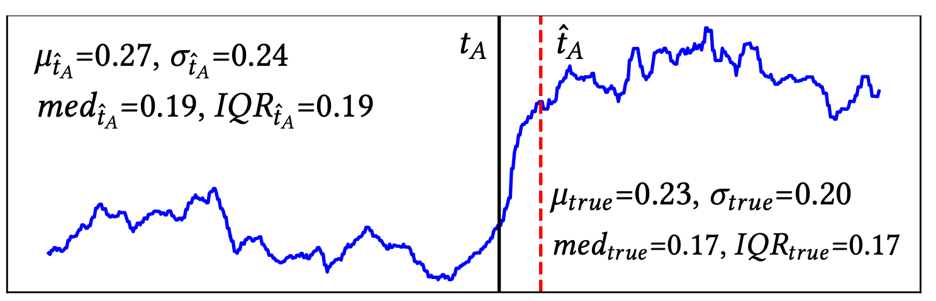
STEP 2
Rank the gauges by how far they moved
1
Learn normal
2
Measure the move
3
Rank them
Before the break, find each gauge's middle value (the median).
After the break, how far did it move from that middle?
Biggest move goes to the top. The top gauge points to the service.
Why middle, not average
Call the start late and some broken data gets counted as normal. That drags the average. The middle barely moves.
Think of Bill Gates walking into a bar.
Pham et al. (2024), Fig. 3b. Solid line: real start. Dashed red: start called late.
Aaron Gesmer · SEIS 616 · BARO
6 / 12
Notes:
About 75 seconds.
Analogy: Ten people in a bar earn about $50k. Bill Gates walks in. The average jumps to billions. The middle person still earns about $50k.
Once BARO knows when things broke, it has to figure out what broke.
[The three boxes] For every gauge, it does three things. It learns the gauge's normal level. It checks how far the gauge jumped after the break. And it puts the biggest jumps at the top of the list.
For example, say the payment service's memory normally sits around 40 percent and jumps to 95. That's a huge jump, so payment goes to the top of the list.
[Graph] Here's the catch. This blue line is one gauge over time. The black line is when it really broke. The red dashed line is when the alarm went off, a little late. BARO treats everything before the red line as normal, so a few broken readings get mixed into normal.
[Dark box] If you use the average, those broken readings pull normal up. Then the real jump looks smaller, and the real culprit can slide down the list. It's like Bill Gates walking into a bar: the average salary shoots up, but the middle salary doesn't move. BARO uses the middle, so the real culprit stays on top.
(Do not read the symbols in the graph's corners.)

Slide 7
THE TEST
Three test apps, one big one
Online Boutique
Sock Shop
Train Ticket
12 services
49 gauges
11 services
46 gauges
64 services
212 gauges
A small online store.
Another small store.
Big. The real test.
100
4
1–3 s
5
tests per app
ways to break it
until symptoms show
servers
They broke things on purpose: overloaded the CPU, leaked memory, slowed the network, dropped data.
Each app was restarted fresh after every test.
Aaron Gesmer · SEIS 616 · BARO
7 / 12
Notes:
About 40 seconds.
Analogy: A teacher who writes the test also has the answer key. Breaking things on purpose gave the authors the answer key.
To test this, the authors built three apps. [First two cards] Two small online stores, [Train Ticket card] and one big train booking app with 64 services.
[Numbers row] Then they broke them on purpose, 100 times per app, in four ways: overloading the CPU, leaking memory, slowing the network, and dropping data.
Because they broke things themselves, they always knew the right answer. That gave them an answer key to grade BARO and the other tools.
[Bottom line] One detail: they restarted each app fresh after every test. I'll come back to that.

Slide 8
RESULTS
The big app is where BARO pulls ahead
Boutique
Sock Shop
Train Ticket
BARO alarm score
0.82
0.75
0.81
BARO culprit score
0.86
0.95
0.81
Map-based tool
0.80
0.60
0.28
Old simple tool
0.74
0.83
0.75
Culprit score: 1.0 means the real culprit is always first on the list. Higher is better.
On the small apps, everyone does fine. On the big app, the map-based tool drops to 0.28. BARO stays at 0.81.
BARO caught every failure. It still raised some false alarms, just fewer than the other tools.
Aaron Gesmer · SEIS 616 · BARO
8 / 12
Notes:
About 65 seconds.
Analogy: The culprit score is a police lineup. Pointing at the right person first scores best; fifth still counts, but less.
Here's the report card. Every number is a grade from 0 to 1. Higher is better.
[BARO culprit score row] The culprit score asks: when the tool handed over its list, was the real broken service at the top? A 1 means it was always first. On the big app, BARO gets 0.81, so the real culprit was usually at or near the top.
[Point at the orange 0.28] Now the map-based tool on the same big app: 0.28. Its map fell apart at that size, and the real culprit usually wasn't near the top.
[Boutique and Sock Shop columns] On the small apps, everyone does okay. The big app is where BARO pulls ahead.
[BARO alarm score row] The top row is about noticing the failure in the first place. BARO caught every failure. It had some false alarms, but fewer than the other tools.

Slide 9
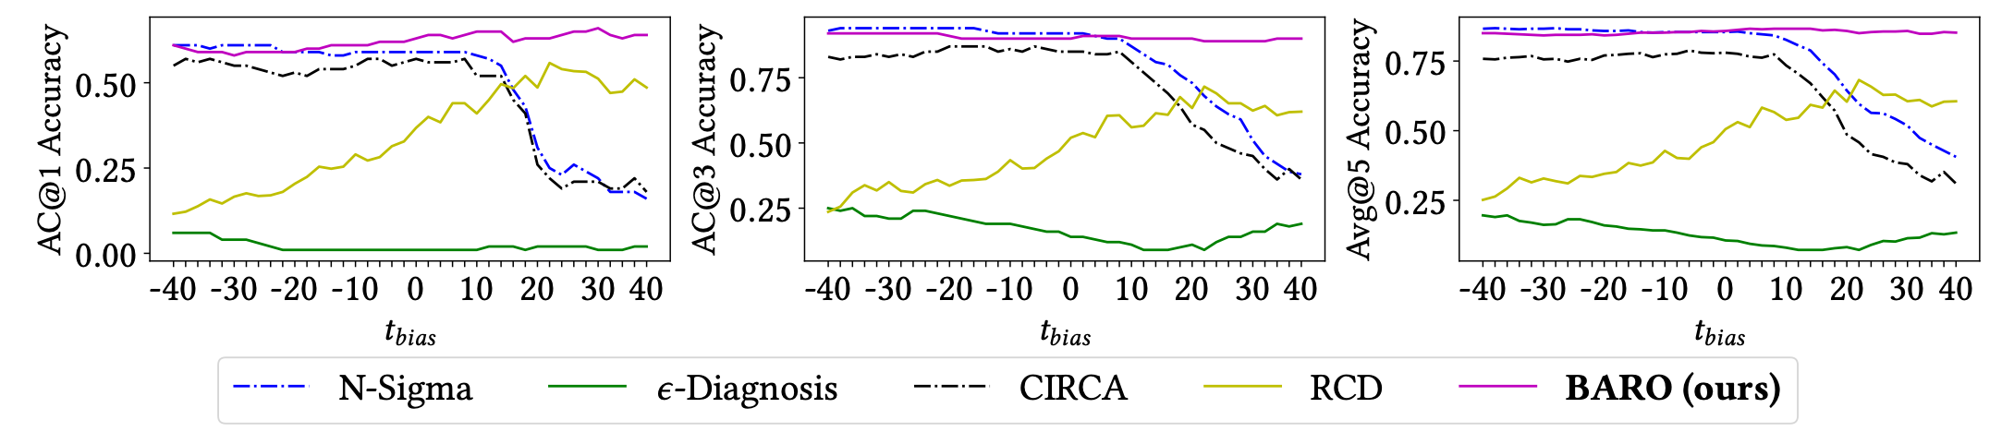
RESULTS
Move the clock and BARO holds still
Pham et al. (2024), Fig. 5, small store app. Higher is better. Left of center: start called early. Right: called late.
Late is the danger
BARO stays flat
Swap only step 2
Call the start late and the average-based tools (N-Sigma, CIRCA) slide down.
Same tests, same shifts. BARO's pink line barely moves.
Keep BARO's step 1 but rank with averages: the big app drops from 0.81 to 0.30.
Aaron Gesmer · SEIS 616 · BARO
9 / 12
Notes:
About 60 seconds.
Analogy: A good GPS still gets you there if you start a block off. A bad one sends you the wrong way.
This is the most important test. The authors made the alarm time wrong on purpose, earlier or later, and graded every tool again.
[Graph] Here's how to read it. Left to right is how wrong the alarm time was. The middle is the right time. To the right of the middle, the alarm was late. Up and down is the grade. The three charts are three ways of grading, and they tell the same story, so just look at one.
[Point at the pink line] BARO is the pink line. It stays flat, so a wrong time doesn't hurt it.
[Late is the danger card, point at the blue and black dashed lines on the right] These two tools use the average. When the alarm is late, they drop. That's Bill Gates from slide 6, showing up in real results.
[Third card] And when the authors kept BARO's step one but swapped in the average, its big-app score fell from 0.81 to 0.30. Using the middle is what makes it work.
(If asked about the green and yellow lines: two other competitors. They don't change the point.)

Slide 10
CAVEATS
What I would not overclaim
Close race
Perfect clock, tie
Naming the exact gauge
The edge is a guessed time
BARO is good at naming the broken service. Naming the exact gauge is a close race.
Give the old simple tool the exact failure time and it scores about the same as BARO.
15 of 100
Lab conditions
Map tool on the big app
Staged failures, one at a time
Its map-drawing step failed on 85 tests, and it got a guessed map, not a real one.
Four kinds of failure, caused on purpose, with a fresh restart each time.
Aaron Gesmer · SEIS 616 · BARO
10 / 12
Notes:
About 55 seconds.
Analogy: With a perfect stopwatch, any runner's time is accurate. BARO's edge only shows up when the stopwatch is off, and in real life it usually is.
Now, what I would not overclaim.
[Perfect clock card] First, if you give the old simple tool the exact failure time, it does just as well as BARO. With a perfect stopwatch, any runner's time is accurate. BARO's edge is that in real life the stopwatch is usually off.
[Close race card] Second, BARO is good at naming the broken service, but naming the exact gauge is a close race.
[15 of 100 card] Third, to be fair to the map tool: on the big app its map-drawing failed on 85 of 100 tests, and it was given a guessed map, not the real one it was designed for.
[Lab conditions card] And finally, these are lab tests. Staged failures, one at a time, with a fresh restart each time.

Slide 11
REFLECTION
A to-do list, not a self-healing system
Ready now
Not yet
Ranking takes about 0.01 seconds.
Nothing to train, no map to maintain.
Still works when the clock is off.
Code and data are public.
Spotting the failure takes 30 seconds to 7 minutes.
Only tested on staged failures in a lab.
Never run for a week without a restart.
What I would add: logs and traces (the authors plan this too), a flag when several services broke together, and a test on a system that is not reset after every failure.
Aaron Gesmer · SEIS 616 · BARO
11 / 12
Notes:
About 60 seconds.
Analogy: The triage is instant, but the lab results take a while. Ranking takes 0.01 seconds; spotting the failure takes up to 7 minutes.
So would I use it? Yes, but as a to-do list for a person, not a system that fixes itself.
[Ready now box] What's ready now: the ranking takes about a hundredth of a second. There's nothing to train and no map to maintain. It still works when the clock is off. And the code is public.
[Not yet box] What's not ready: spotting the failure takes thirty seconds to seven minutes. It's like instant triage but slow lab results. And it was only tested in a clean lab. Restarting after every test is like crash-testing a car on a fresh track every time. It never had to survive a muddy week-long road trip.
[Bottom line] What I'd add: logs and traces, which the authors plan too; a flag when several services break together; and a test on a system that isn't reset after every failure.

Slide 12
THE CLAIM I WOULD DEFEND
Watching the signals together
means fewer false alarms. Using
the middle value keeps the list
right when the clock is off.
That is what still works when the system gets big.
Pham, L., Ha, H., & Zhang, H. (2024). BARO: Robust root cause analysis for microservices via multivariate Bayesian online change point detection. Proceedings of the ACM on Software Engineering, 1(FSE), Article 98.
https://doi.org/10.1145/3660805
github.com/phamquiluan/baro
Figures on slides 6 and 9 are from Pham et al. (2024), Figs. 3b and 5.
Notes:
About 30 seconds.
Analogy: Back to Bill Gates: use the middle, not the average, and the list stays right when the clock is wrong.
[Read the slide] Watching the signals together means fewer false alarms. Using the middle value keeps the list right when the clock is off. That is what still works when the system gets big.
[Pause] Thank you. I'm happy to take questions.

